Slide 1

Business Communication & Skills Development Level 1-Semester 1
Prepared by : Tissa Wijesuriya
PGDE (English Medium) – The University of Colombo
B.A. (The University of Kelaniya)
Advanced English Diploma. (The University of Colombo)
MACO Diploma (The University of Kelaniya)

Slide 2

What is communication?
Communication is a process of exchanging information ideas, thoughts, feeling emotions through speech, signals, writing or behaviour
Communication is the process of sending and receiving information among people
Receiver
Sender
Sender
Receiver
Decode

Slide 3
Activity 1
Forward your ideas on what is “communication”.
Make your own definition for communication and present it to the class

Slide 4
Communication Process
Communication is the process of conveying a message to others and requires six elements: a source, a message, a channel of communication, a receiver and the process of encoding and decoding
Message Sender
Encode
Channel
Decode
Recipient/s
feedback
Decode
Encode

Slide 5
What is Business Communication?
Business communication is the process of sharing information between people within and outside a company in order to promote an organization's goals, objectives, aims and activities, as well as increase profits.
The transmission of information within the business environment. The information may be transmitted - sent and received - between or among individuals.
Business communication occurs between two or more parties to exchange business related information

Slide 6
What is Business Communication?(Cont.)
When the communication occurs between either two or more than two businesspeople for the purpose of effective organization and administration of business, then it is considered as business Communication( Prof. J. Haste)
Business communication as a system that is responsible to affect change throughout the whole organization- Risks and Grow
Communication is exchanging business related different views, ideas, and news within the related parties. (W.H. Business)

Slide 7
Activity 2
Forward your ideas on what is “business communication”.
Make your own definition for the business communication and present it to the class

Slide 8
Why business communication is important ?
Helps in increasing Productivity - Effective business communications increases productivity of staff by boosting up teamwork. It creates trustworthy and understand between employers and employees The scope of doing mistakes or errors during their work minimizes.
Helps in increasing customers - Customers are an important part of any business. Effective business communication can facilitate in attracting new customers and retain current customers.
Enhances business partnerships- Effective business communication can attract other business units. So, it improves partnerships in business.
Facilitates innovations in business - It facilitates employees to convey their ideas and suggestions openly.(E.g.: At the time of launching any new product in the market

Slide 9
Why business communication is important?(Cont.)
Information exchange.- It is necessary to exchange the information with internal and external stakeholders
Preparation of plans and policies
Execution or implementation of plans and policies
Boost the efficiency of employees
Goals achievement

Slide 10
Why business communication is important?(Cont.)
Helps in solving problems or issues.
facilitates decision-making
Helps in brand and product/ service promotions
proper functioning of different departments.
Increases employee satisfaction level and employee loyalty.
Reduces chances of conflicts.

Slide 11
Activity 3
What is the importance of business communication? Give your ideas and explain the reasons for the importance.

Slide 12
Business Communication caters to:
Business planning
Basis of decision making
Creating coordination and cooperation
Establishment of effective leadership
Development of human relations
Helpful in building image
Helpful in achieving peace and effective control
Leading to high morale and motivation
Unseen infrastructure of an organization
Helpful in delegation of authority.

Slide 13
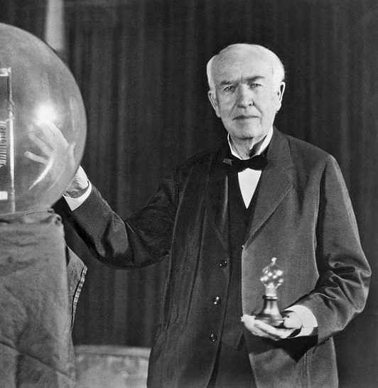
Read the text given and answer all the questions
The Edison lamp from our Attic is dated January 27, 1880. It is a product of the continued improvements Edison made to the 1879 bulb. Even though it is over a hundred years old, this bulb looks very much like the light bulbs lighting your house right now. The base, or socket, on this 19th century lamp is similar to the ones still used today. It was one of the most important features of Edison's lamp and electrical system. The label on this bulb reads, "New Type Edison Lamp. Patented Jan. 27, 1880, OTHER EDISON PATENTS."
"Before I got through," he recalled, "I tested no fewer than 6,000 vegetable growths, and ransacked the world for the most suitable filament material."
"The electric light has caused me the greatest amount of study and has required the most elaborate experiments," he wrote. "I was never myself discouraged or inclined to be hopeless of success. I cannot say the same for all my associates."
"Genius is one percent inspiration and ninety-nine percent perspiration."

Slide 14
Questions
What is the text about?
What is the invention mentioned in the text and who invented it?
What can you say about his invention? Did he invent it over one night?
Give your idea about the person who invented the bulb and comment his effort?
Can you present about another great person like the person who is mentioned in the above text to the class?

Slide 15

Thank You!!!

